Slide 1
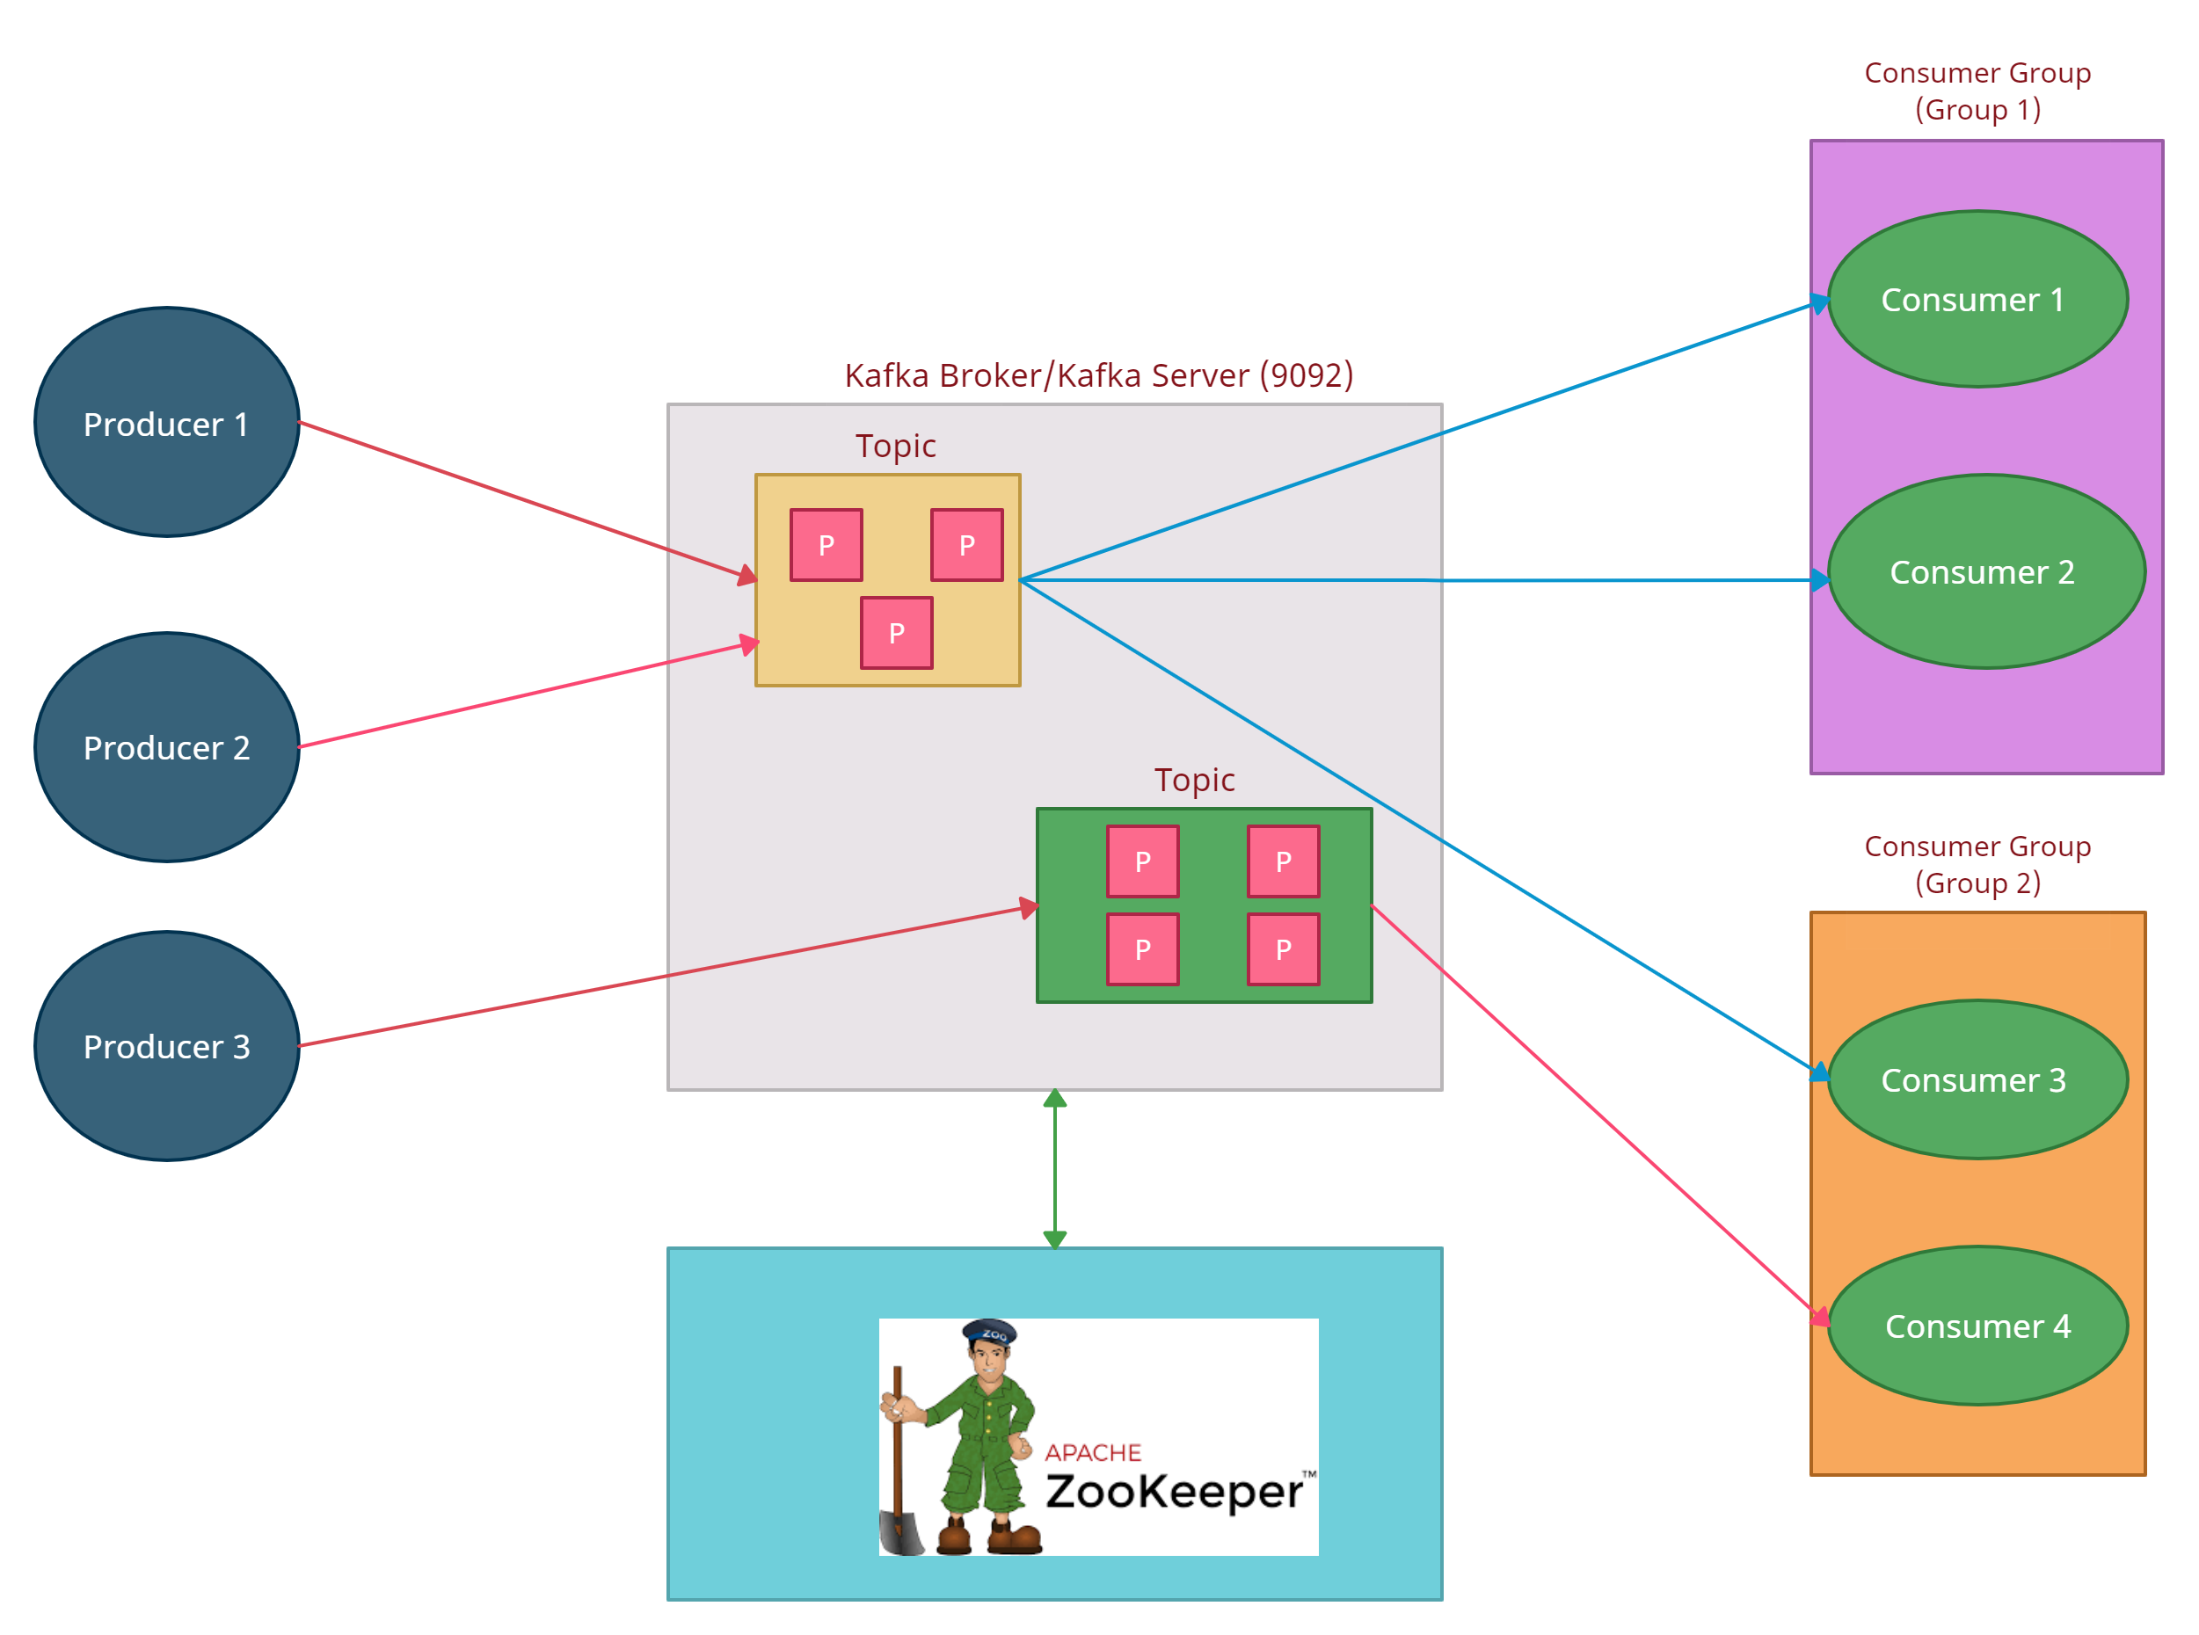

Kafka Architecture
Which messages consumer has read
Cluster information
Topic configuration
Zookeeper is a distributed, open-source configuration, synchronization service

